Slide 1
Surface Pattern Recognition Using Shape Subspace
Naish Ibrahim
Supervisor: Kazuhiro Fukui
Notes:
Good afternoon everyone. My name is Naish Ibrahim, and today I will present my research on Surface Pattern Recognition Using Shape Subspace.

Slide 2
Contents
Research Problem
Research Background
Related Research
Proposed Method
Experiment
Future Work
Conclusion
Notes:
Today's presentation will cover the following sections.
Let’s start by understanding the research problem.

Slide 3
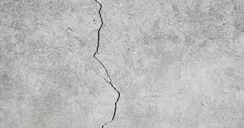
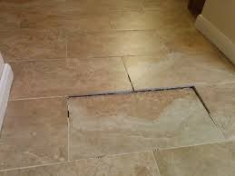
Research Problem
How can Subspace-based methods be used to detect surface irregularities in Point Cloud data?
Notes:
Our research aims to address the following question:
How can subspace-based methods be used to detect surface irregularities in point cloud data?
Point clouds are commonly used in applications such as quality control and robotics, where detecting small surface defects is critical.
Traditional methods for surface analysis, such as curvature estimation and edge detection, often find difficulties in identifying minor deformations, especially in complex surfaces. Our research aims to address these limitations by leveraging subspace-based methods to provide a more robust and efficient method for surface pattern recognition

Slide 4
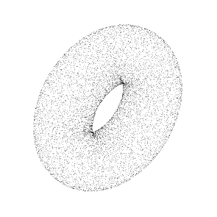
Research Background
Point Cloud Processing
(100,150,100)
Point Cloud processing involves handling 3D data represented as a collection of points in space (x, y, z) coordinates.
Example of point cloud data file
X | Y | Z
100 | 150 | 100
200 | 200 | 210
10 | 50 | 100
35 | 10 | 35
R | G | B
13 | 115 | 24
32 | 102 | 35
15 | 57 | 78
33 | 43 | 25
X | Y | Z
1 | 0 | 3
-1 | 1 | 0
0 | -2 | 0
2 | -1 | 1
Coordinates
Color (Optional)
Normal Vectors (Optional)
Notes:
Let’s begin with an overview of point cloud processing.
A point cloud is a set of data points in a three-dimensional space, where each point represents a position on the surface of an object.
Point cloud data is typically obtained using sensors like LiDAR and structured light scanners, and is commonly used in applications such as 3D mapping, object recognition, and quality inspection.
Despite its usefulness, processing point cloud data presents several challenges.
One of the main challenges is that point clouds are unstructured, meaning they lack inherent connectivity information between points.
Another challenge is the presence of noise and inconsistencies, which arise due to environmental factors or sensor limitations.
In addition, handling large-scale point cloud data can be computationally expensive, requiring efficient algorithms for real-time processing.
To overcome these challenges, our research explores subspace-based methods that provide a mathematical framework to analyze and extract meaningful geometric information from point cloud data

Slide 5
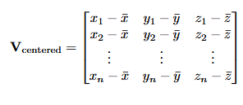
Research Background
Shape Subspace
A mathematical representation of 3D structures based on the relative positions of feature points.
Used for task such as object recognition, motion analysis, and biometric authentication.
Representing high-dimensional data efficiently.
centering
Apply SVD
Centered matrix
Input point cloud
Shape Subspace
Notes:
Shape subspace is a fundamental concept in our research, as it provides a compact representation of the geometric structure of point clouds.
The process begins by centering the data, which involves subtracting the mean position of the points to eliminate any translational bias.
After centering, Singular Value Decomposition, or SVD, is applied to the centered matrix to extract the most significant geometric features.
The resulting subspace captures the primary shape characteristics of the object, allowing us to compare different surfaces efficiently.
By representing the shape in a lower-dimensional space, we can analyze and detect patterns without being overwhelmed by the complexity of the original high-dimensional data.

Slide 6
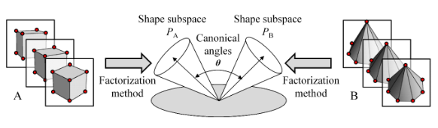
Related Research
How is Shape Subspace computed?
Factorization Approach
Frames of an Image sequence
Frames of an Image sequence
Figure adapted from Igarashi and Fukui, "3D Object Recognition Based on Canonical Angles between Shape Subspaces"
Notes:
Now, let’s look at existing methods related to our research. One such method is the Factorization Approach,
This method decomposes a measurement matrix into motion and shape components by tracking feature points across a sequence of images.
The factorization approach has several advantages.
It is robust to transformations such as translation, rotation, and scaling, making it suitable for various applications.
In addition, the use of canonical angles allows for accurate similarity measurements between different 3D objects.
However, the effectiveness of this method relies on the accurate tracking of feature points, which can be challenging in practical scenarios, especially when dealing with noisy or incomplete data.

Slide 7
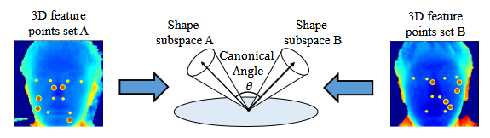
Related Research
How is Shape Subspace computed?
Direct 3D Feature Extraction Approach
Figure adapted from Yoshinuma, Hino, and Fukui, "Personal Authentication Based on 3D Configuration of Micro-feature Points on Facial Surface"
Notes:
Another relevant approach is the Direct 3D Feature Extraction Approach
Unlike the factorization method, this approach does not require tracking feature points over time.
Instead, it directly analyzes 3D point cloud data to extract key geometric features.
It was initially used in personal authentication applications, where micro-feature points (such as moles or facial contours) were analyzed to distinguish individuals.
The process involves identifying key feature points, converting them into a shape subspace, and comparing the subspaces using canonical angles.
By eliminating the need for sequential tracking, this approach offers a more efficient and reliable solution for analyzing complex surfaces.

Slide 8
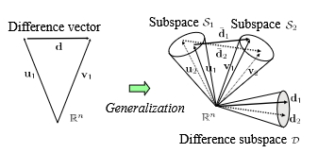
Related Research
The Difference Subspace (DS) is a geometric concept that represents the components of difference between two class subspaces. It extends the idea of a difference vector between two vectors to the case of subspaces.
DS is particularly useful for analyzing and extracting local shape differences between objects, which provides a more sensitive cue for recognition compared to traditional global shape comparison methods.
Figure adapted from Fukui et al., "Second-order Difference Subspace"
Notes:
The third major concept in related research is the Difference Subspace (DS)
Which focuses on capturing local shape variations by comparing the orthogonal projection matrices of different subspaces.
Unlike traditional global comparison methods, the difference subspace technique analyzes localized differences, making it more sensitive to small-scale surface variations.
This approach has proven to be highly effective in detecting subtle deformations that might be missed by conventional methods.
By isolating differences at a subspace level, it provides a precise and computationally efficient way to analyze surface patterns.

Slide 9
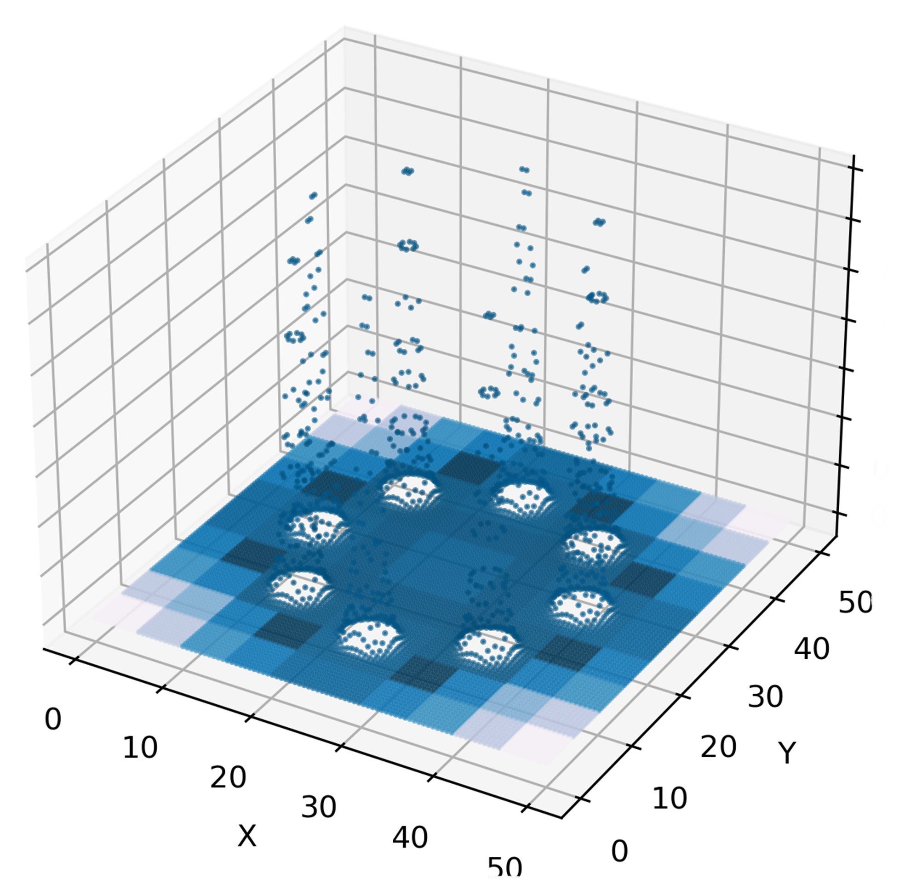
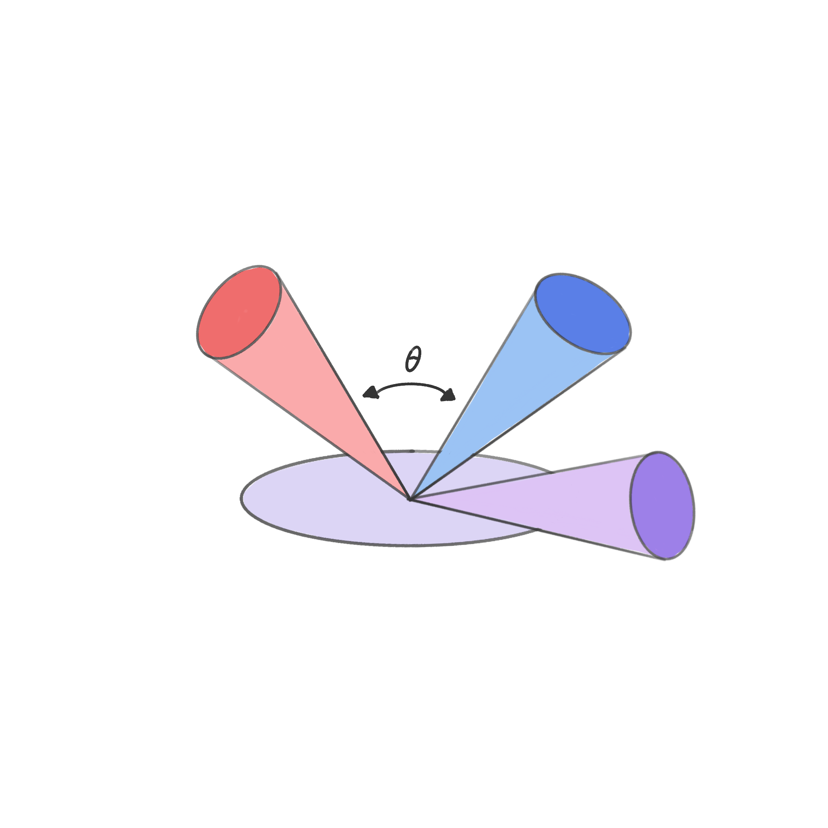
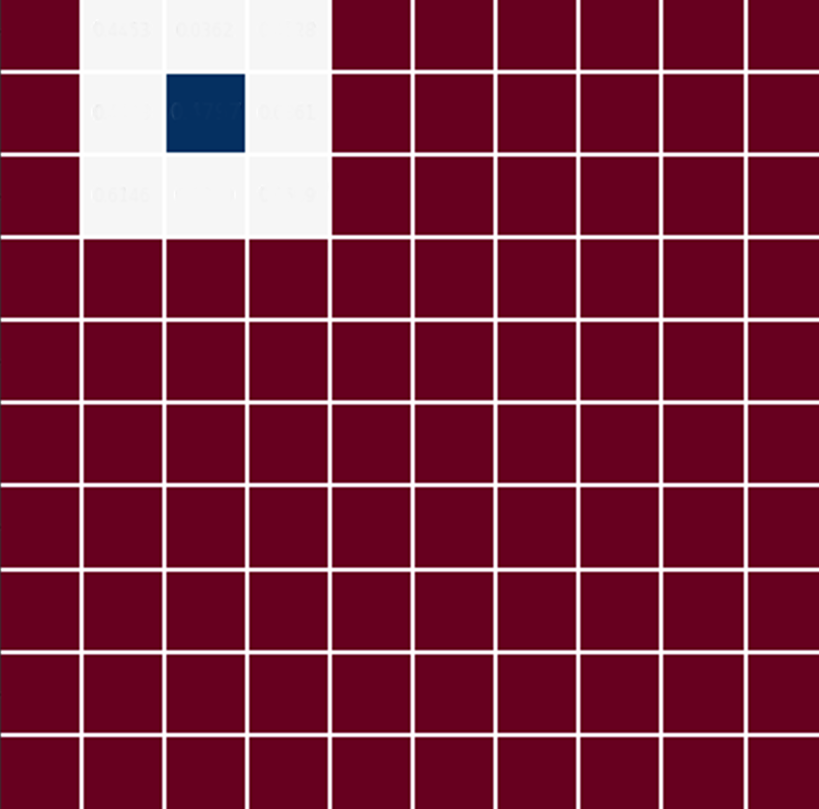
Proposed Method
dividing
centering
Apply SVD
Centered matrix
Shape Subspace
Input Point Cloud
n × n patches
Shape Subspace P
Shape Subspace Q
comparing
Canonical
angles
DS computation
Compare patches using DS
Vector space
Difference Subspace D
Notes:
Our proposed method follows a structured workflow.
First, we input the 3D point cloud data representing the synthetic floor surface.
The floor is then divided into smaller patches to facilitate localized analysis.
Once the patches are defined, we perform centering by subtracting the mean of each patch, which removes translational bias and standardizes the data.
Next, we compute the shape subspace for each patch using Singular Value Decomposition, or SVD, to extract its dominant features.
Finally, we calculate the difference subspace by comparing neighboring patches to detect surface variations.
The Difference Subspace (DS) Method:
Patch A → Shape Subspace S_A (from SVD)
Patch B → Shape Subspace S_B (from SVD)
Step 2: Create Projection Matrices
P_A = S_A × S_A^T
P_B = S_B × S_B^T
Step 3: Sum the Projection Matrices
S = P_A + P_B
Step 4: Get Eigenvalues of S
Eigenvalue decomposition: Sv = λv
Eigenvalues tell us:
λ = 2: Direction in both subspaces (overlap)
λ = 1: Direction in one subspace only
λ = 0: Direction in neither subspace
Step 5: Extract the Difference
Difference Subspace = eigenvectors where λ < 1
These are the directions where patches DIFFER!
Step 6: Measure the Difference
Size/magnitude of difference =
Number of eigenvalues < 1
How close they are to 0
Result: A single number (e.g., 0.8) showing how different the patches are
This approach allows us to systematically analyze the floor surface and identify regions that exhibit deviations from the expected pattern.

Slide 10
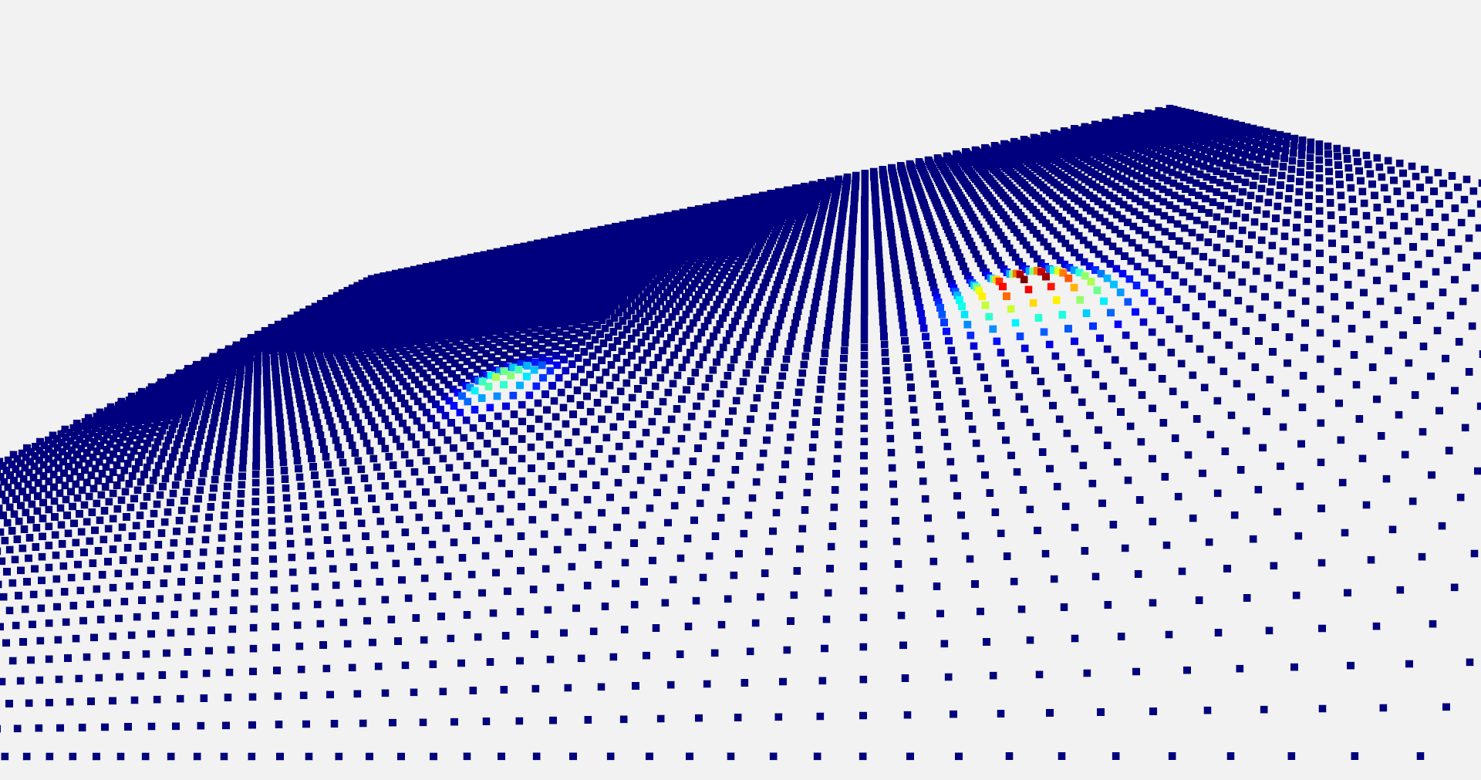
Experiment
Generation of synthetic floor.
Configuration:
The synthetic floor is defined by dimensions of 50 × 50 where each point is spaced exactly one centimeter apart
Total points 10,000
Notes:
To conduct our experiments, we created a synthetic floor surface with the following specifications:
A synthetic floor data with 10,000 uniformly spaced points across a 50x50 cm grid
This synthetic setup provides a controlled environment to evaluate the effectiveness of our method in detecting surface irregularities.

Slide 11
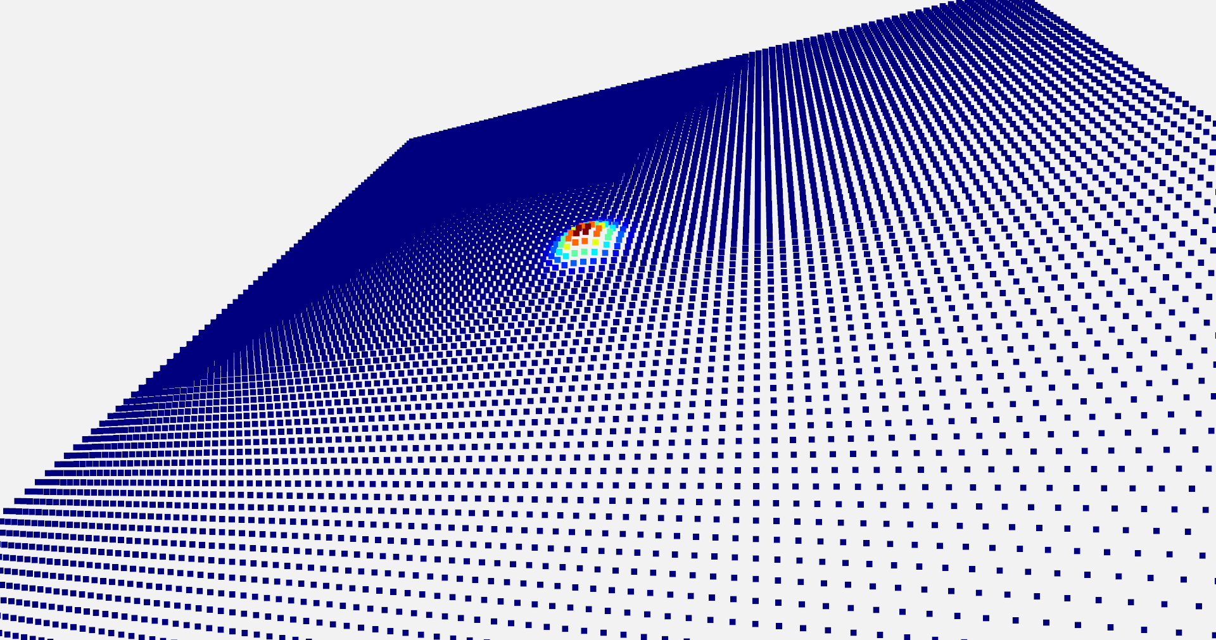
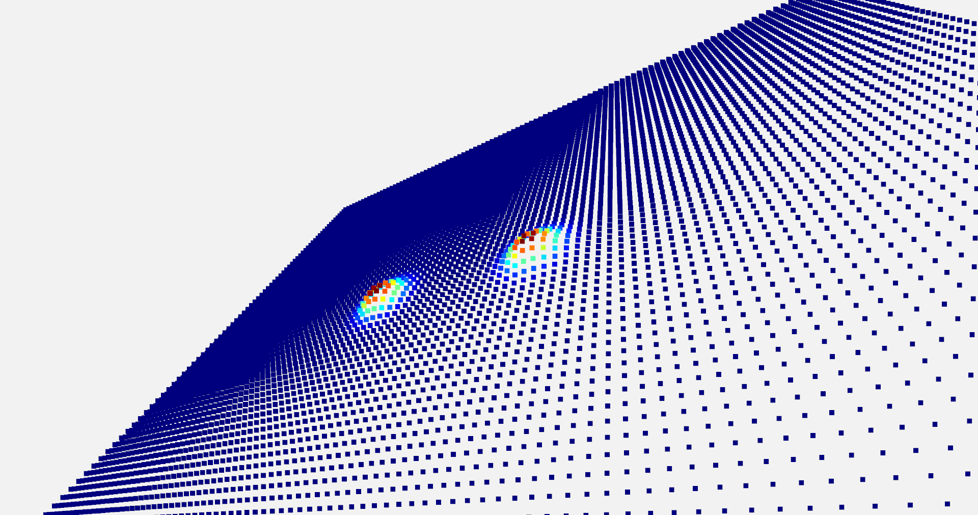
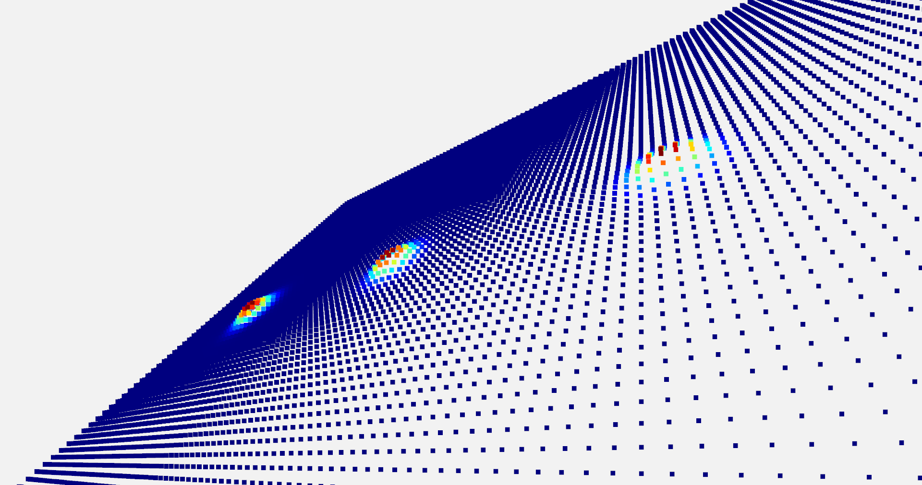
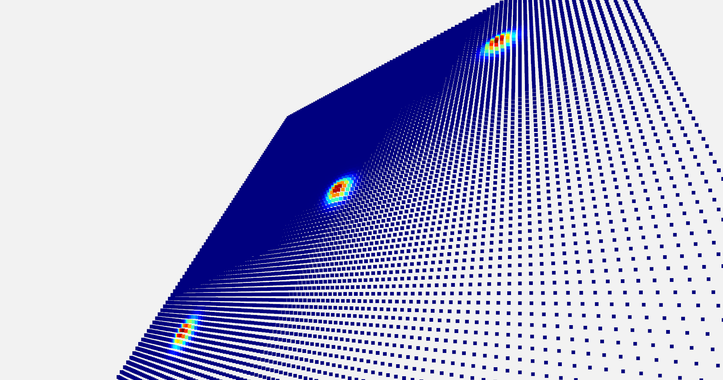
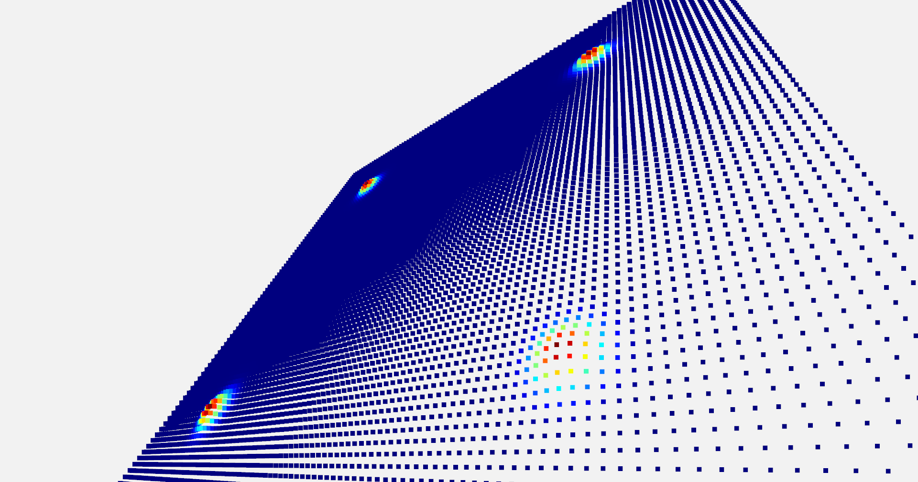
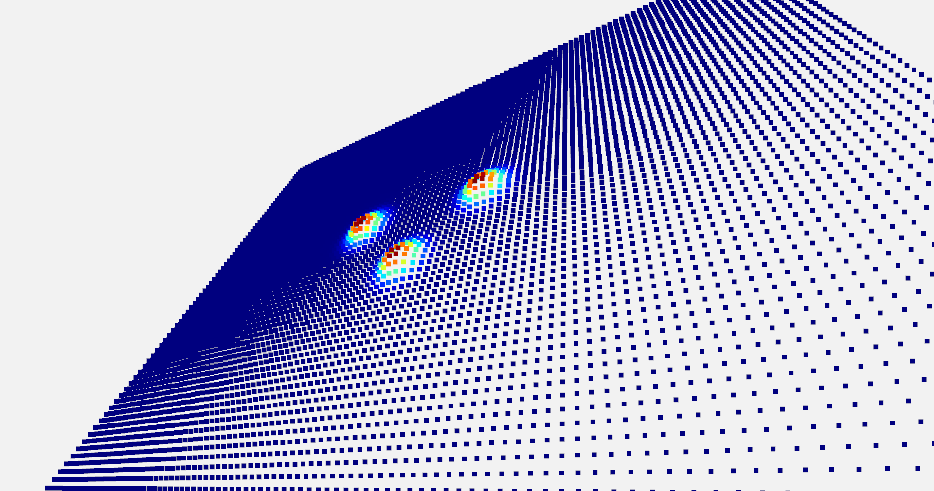
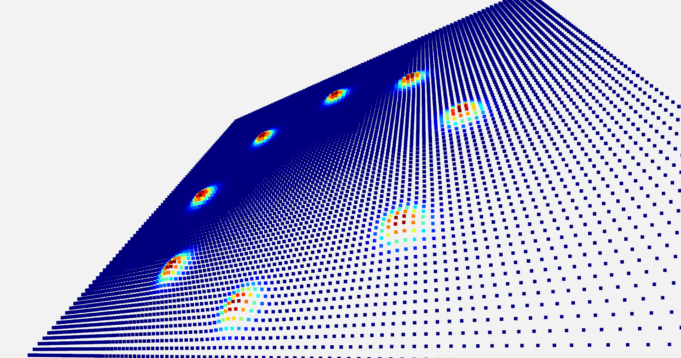
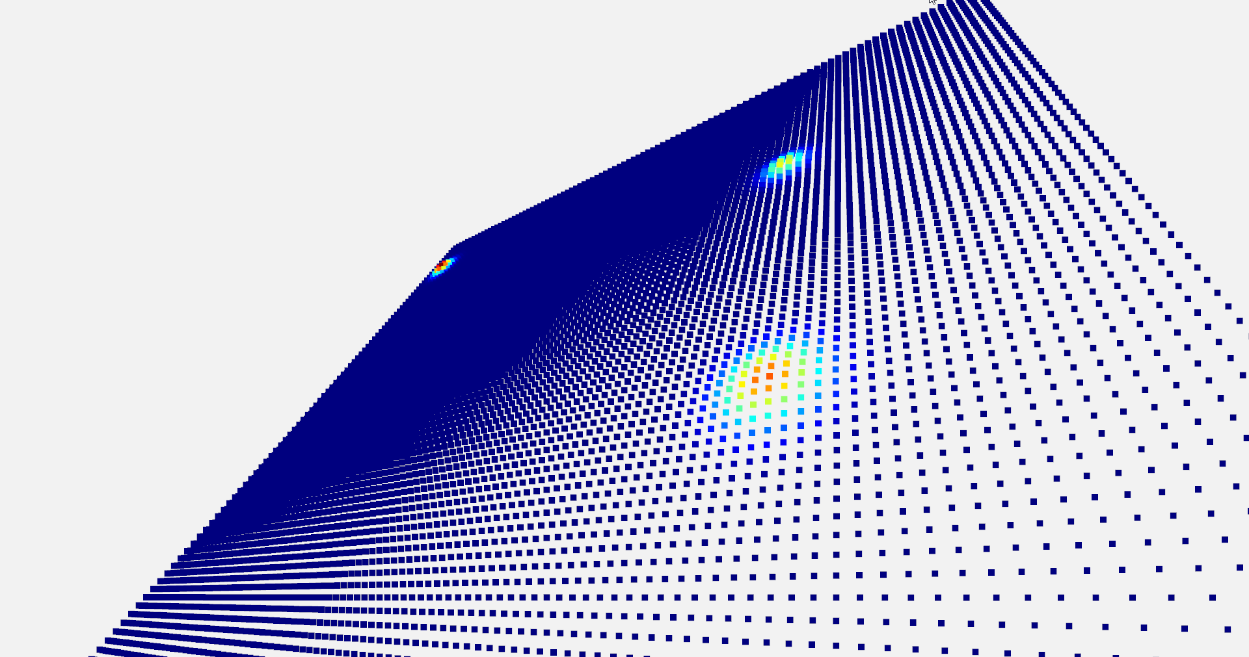
Experiment
Generating predefined or random bumps
Single
Double
Ridge
Diagonal
Corners
Triangle
Circle
Random
Notes:
We introduced several types of surface irregularities to test the robustness of our method.
These include single bumps, double bumps, ridges, corners, and random distributions.
By analyzing these predefined patterns, we can assess the accuracy and reliability of our approach in detecting different types of surface deformations.

Slide 12
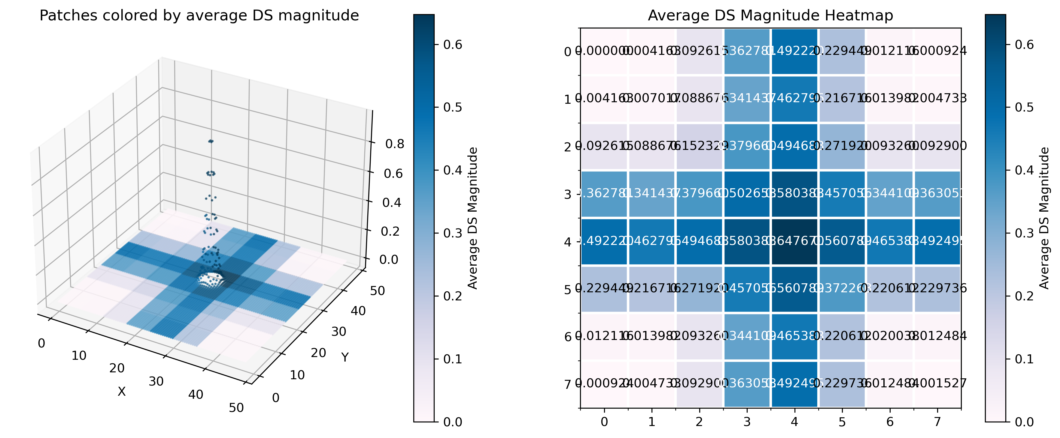
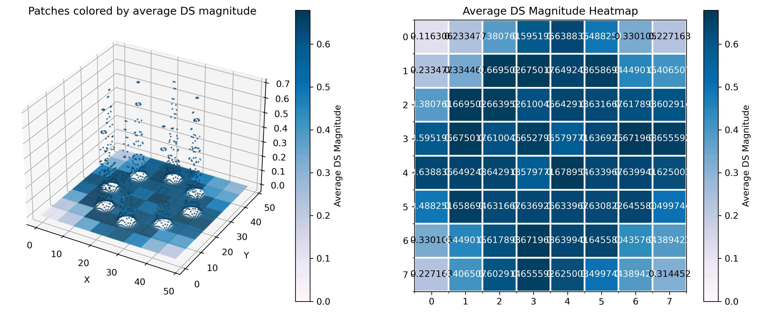
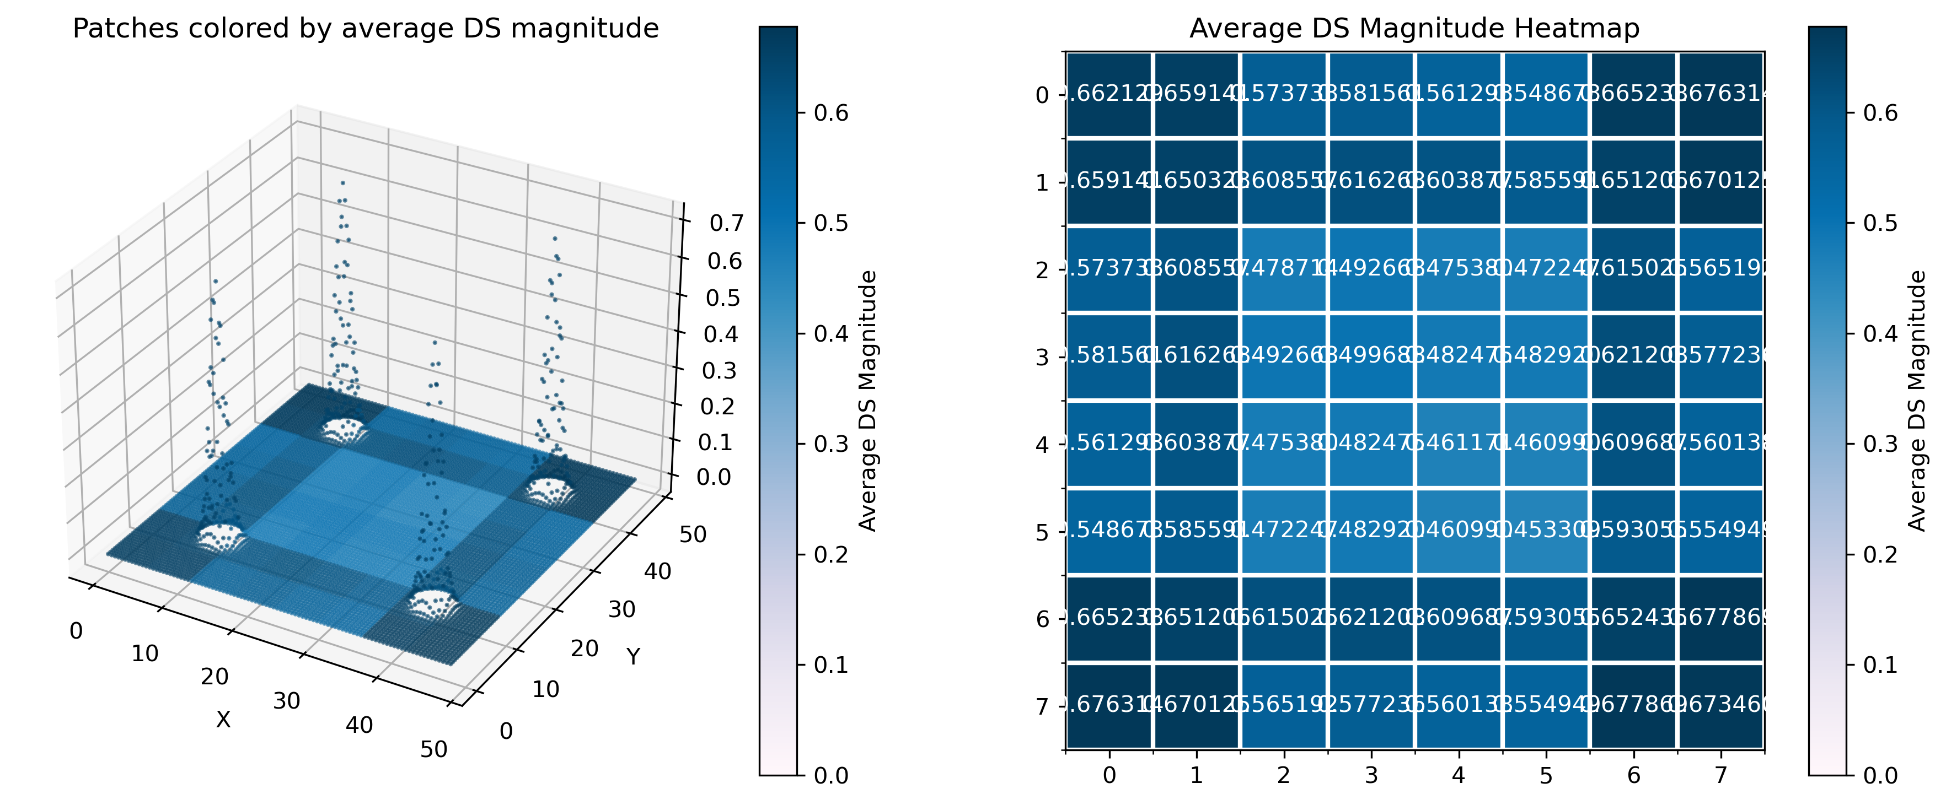
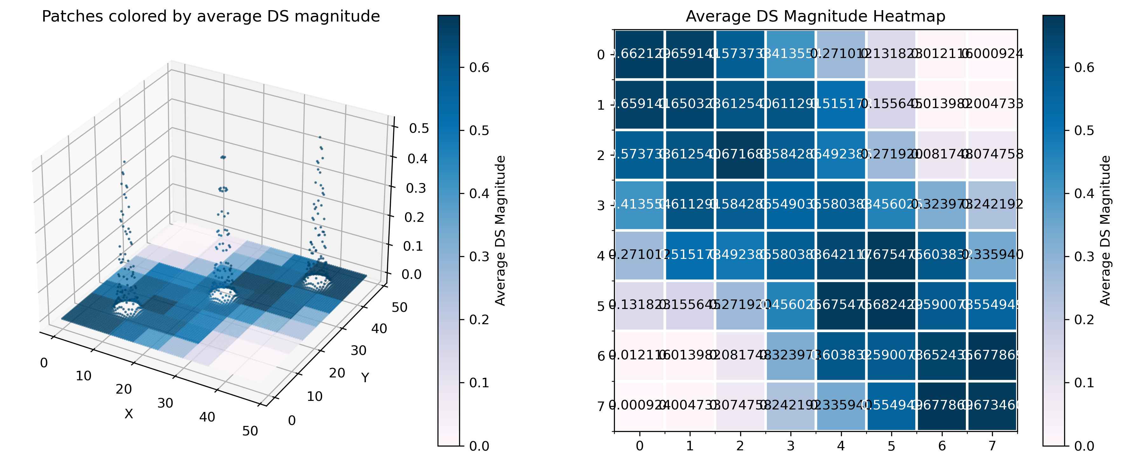
Experiment
Single
Circle
Corners
Diagonal
12

Slide 13
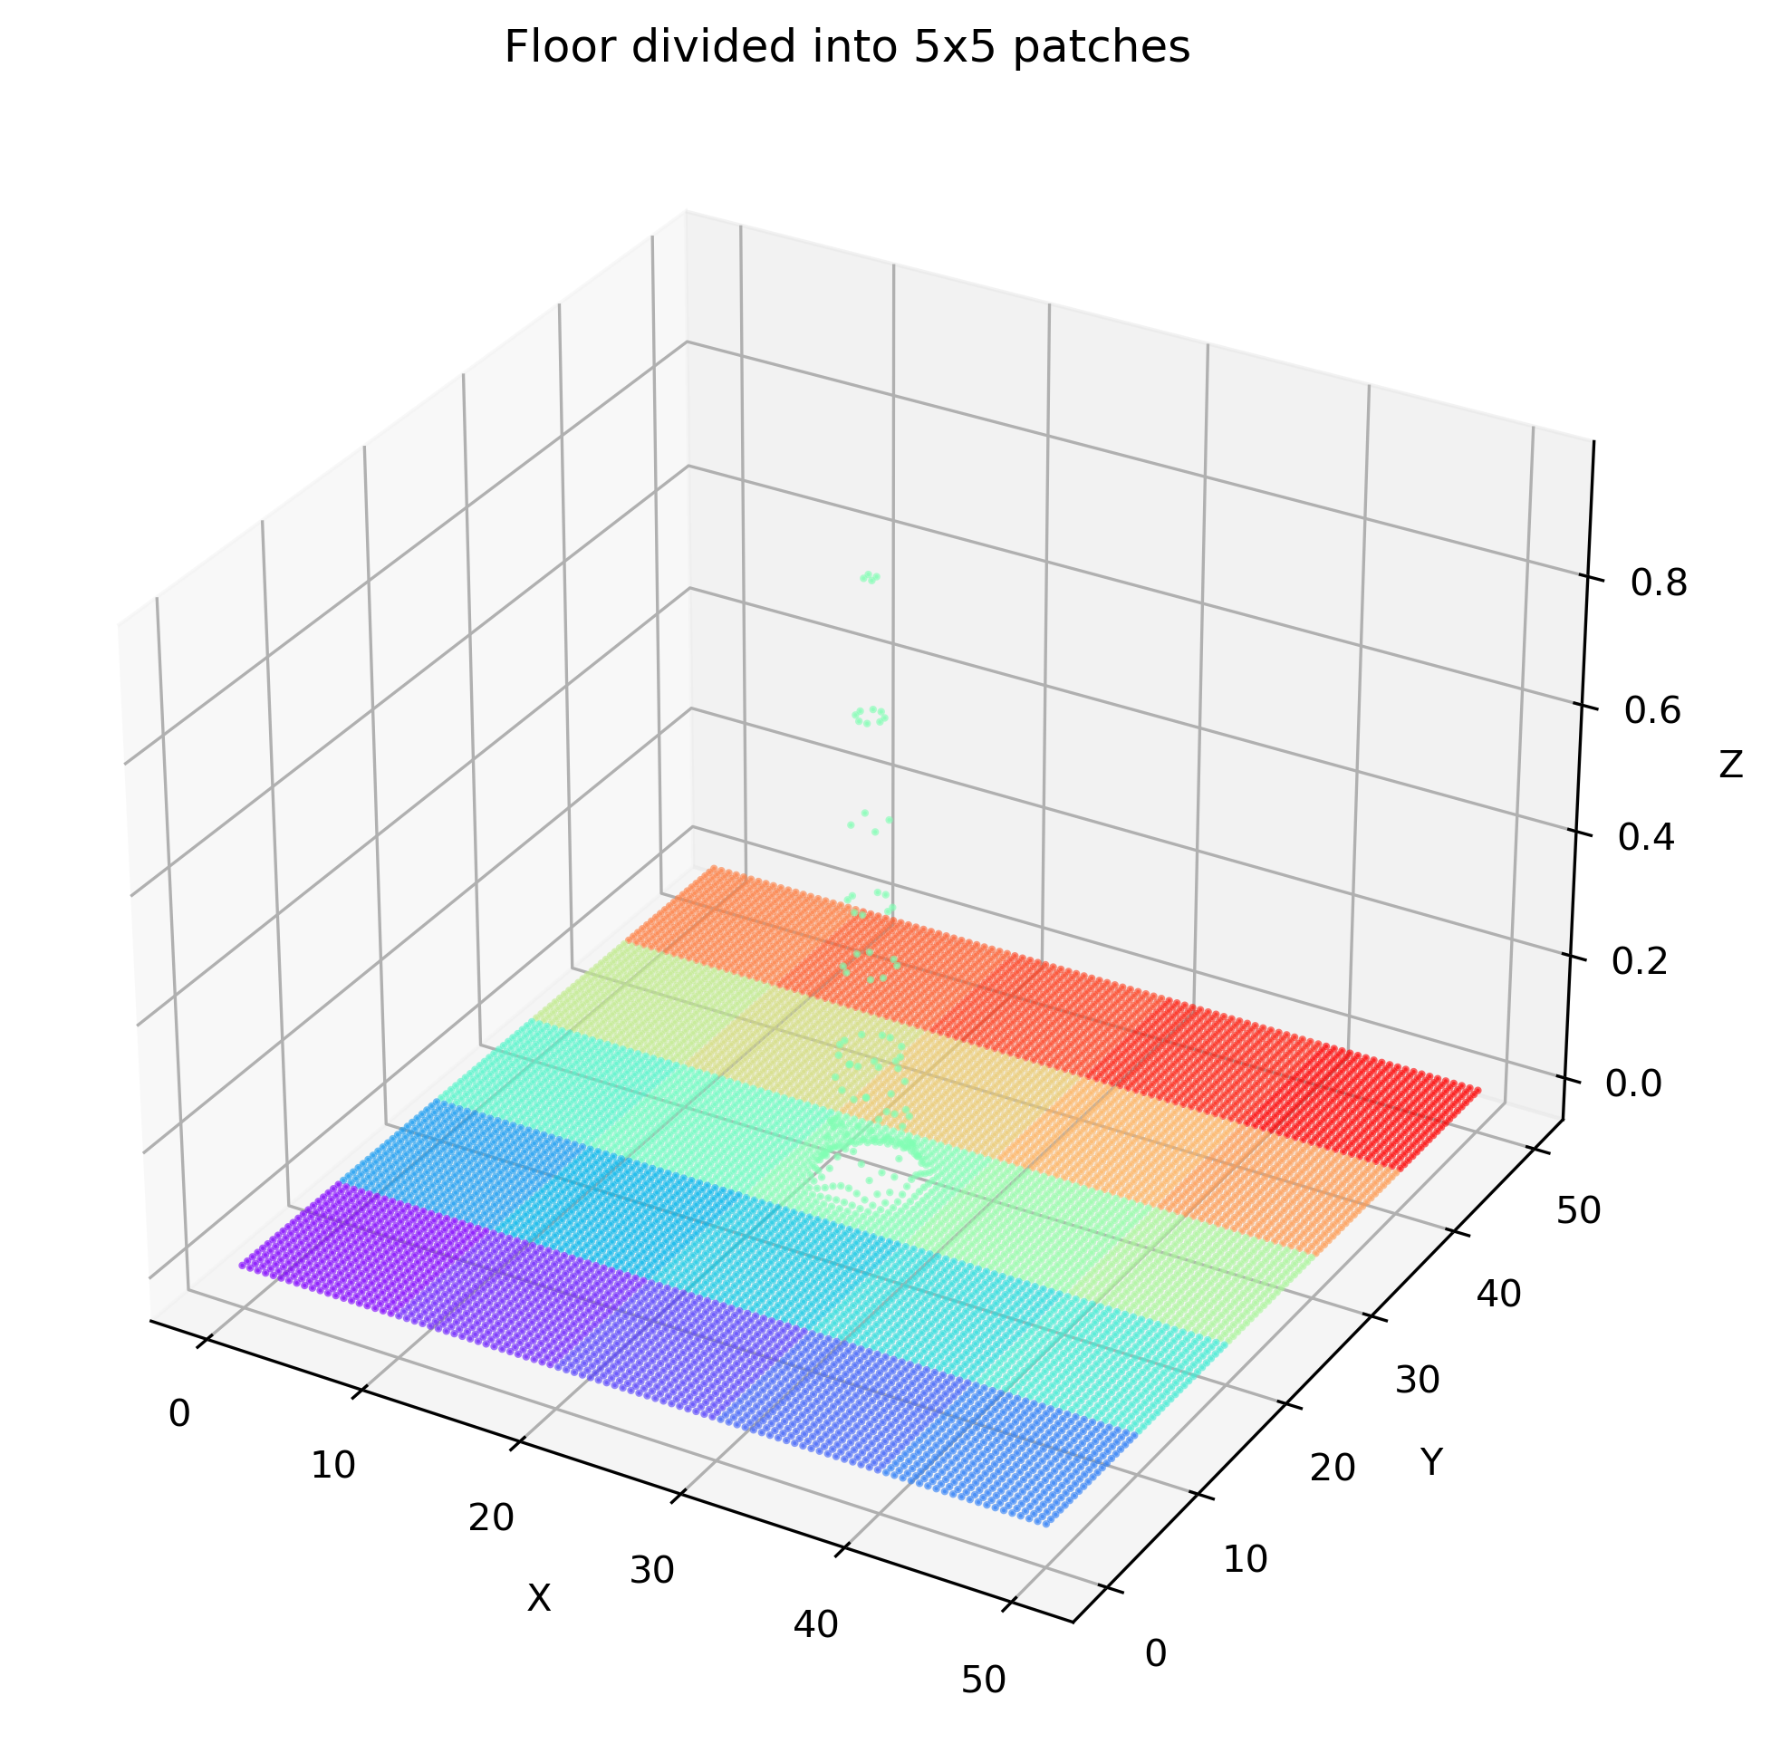
Experiment
Patch division process
Configuration:
Number of patches along x-axis
Number of patches along y-axis
Notes:
The floor surface is divided into smaller patches to facilitate localized analysis.
We experimented with different grid sizes, ranging from 3x3 to 10x10 patches
The patch sizes influence the trade-off between detection accuracy and computational efficiency.
This allows for detailed analysis of smaller surface regions.

Slide 14
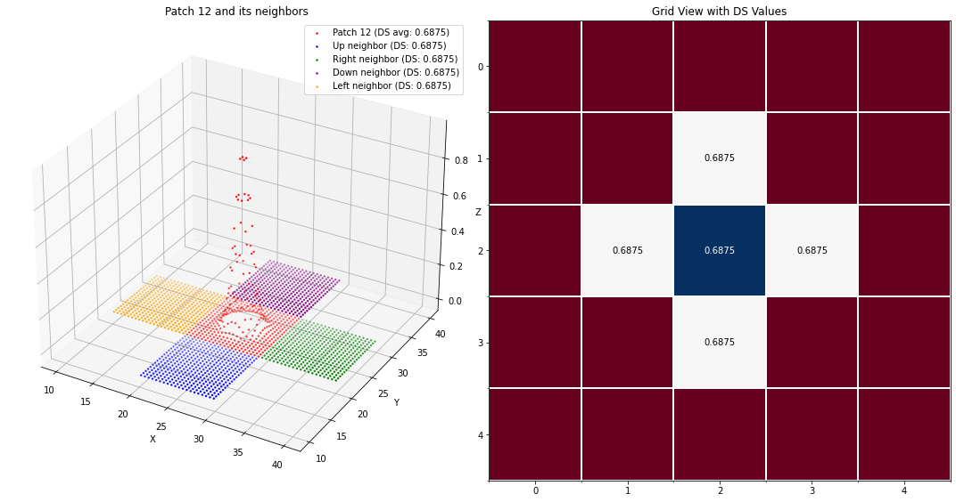
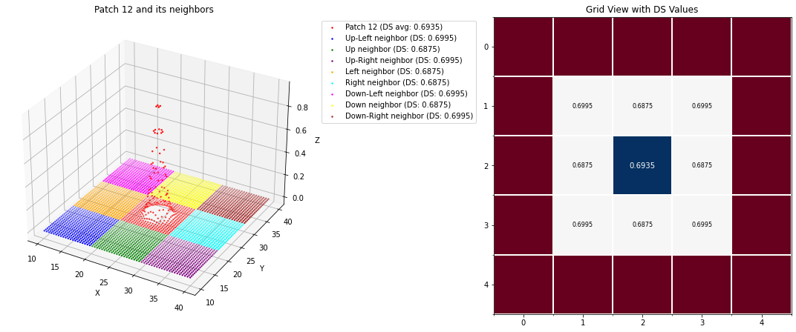
Experiment
DS generation for each patch
4-neighbor approach
8-neighbor approach
Notes:
To detect surface variations, the Difference Subspace (DS) was computed using:
4-neighbor approach, which focuses on immediate neighbors and offers higher sensitivity.
8-neighbor approach, which considers a broader context and provides more stability.
This comparison helps in understanding the effectiveness of different neighborhood configurations.

Slide 15
Summary of Initial Research
Methodology:
Data: Experiments were conducted on synthetically generated 3D floor surfaces, meticulously defined with dimensions of 50×50 units and comprising 10,000 precisely spaced points. This allowed for controlled testing with known anomaly patterns.
Segmentation: The synthetic floor surfaces were systematically segmented into uniform, non-overlapping patches (e.g., 8×8 grids).
Shape Subspace Computation: For each individual patch, its Shape Subspace was computed via Singular Value Decomposition (SVD) of its centered point matrix.
Difference Subspace (DS) Calculation: Difference Subspaces were then calculated between neighboring patches. This allowed for the quantification of local geometric variations across the surface, with higher DS values indicating greater differences or anomalies.
Key Results & Summary:
Pattern Detection: The method successfully detected a variety of predefined synthetic patterns, including distinct bumps (single, double), linear features (ridges, diagonals), and localized shapes (corners, circles, triangles, random irregularities).
Accuracy and Stability:
Smaller patch sizes (e.g., 3×3, 4×4) were found to yield higher accuracy for detecting fine-grained surface details and localized anomalies.
The use of an eight-neighbor approach (comparing a central patch with its eight surrounding neighbors) offered improved stability and robustness for identifying more complex or extended patterns compared to a four-neighbor approach.

Slide 16
Limitations Identified in Previous Work
Boundary Sensitivity:
Issue: Fixed, non-overlapping patch boundaries could arbitrarily cut across anomalies, potentially diluting the anomaly signal or causing detection inaccuracies at the edges of the patches.
Impact: This led to less precise localization and a higher risk of false negatives or poorly defined anomaly regions.
Limited Spatial Resolution:
Issue: The use of discrete, non-overlapping patches meant that analysis points were sparse across the surface.
Impact: This resulted in a coarser representation of the surface and limited the ability to detect fine-grained anomalies or precisely locate their extent.
Unvalidated Performance on Noisy Real-World Data:
Issue: The initial experiments were conducted exclusively on clean, synthetically generated data.
Impact: The robustness and effectiveness of the method in the presence of real-world noise, data irregularities, and varying point densities remained unconfirmed.

Slide 17
Sliding Window Approach
Concept
Overlapping Analysis Regions: Instead of fixed, discrete patches, the sliding window introduces analysis regions that overlap with configurable percentages.
Continuous Coverage: This overlap ensures that every point on the surface is analyzed multiple times from different window perspectives, mitigating the boundary sensitivity issues of fixed patches.
Increased Spatial Resolution: By generating more analysis points (windows) across the surface, the method achieves a much finer spatial resolution for anomaly localization and characterization.

Slide 18


Methodology
Given a point cloud with overall bounding box dimensions (W,H) in the horizontal plane:
Window Size: (w,h) represents the dimensions of each individual analysis window.
Overlap Percentage: α∈[0,1) defines the degree of overlap between adjacent windows (e.g., α=0.5 for 50% overlap).
The stride parameters (sx​,sy​) — the distance the window moves for each step in X and Y directions — are calculated as:

Slide 19



Methodology
The resulting grid dimensions (Nx​,Ny​) — the total number of windows in the X and Y directions become:
Each window Wi,j​ at grid position (i,j) encompasses points within the region defined by:
where (xmin​,ymin​) are the minimum coordinates of the overall point cloud.

Slide 20
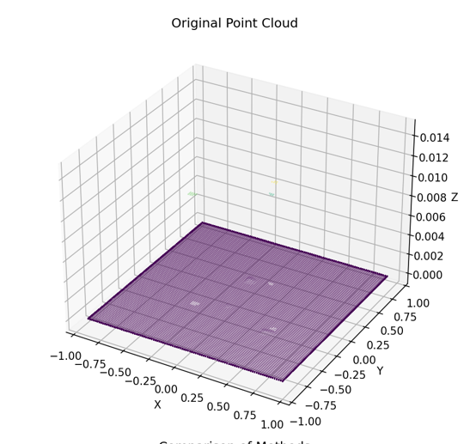
Experimental Validation
Comparison Methods
Fixed Patches (Baseline):
Configuration: An 8×8 grid, resulting in a total of 64 discrete analysis points (patches). This served as the reference for comparison, reflecting our previous work.
Sliding Window (Proposed):
Configuration: Utilized a 50% overlap between adjacent windows. This design significantly increases the density of analysis points across the surface.
Data Used
Synthetic Data:
Description: Artificially generated 3D floor surfaces.
Dimensions: 50×50 units.
Point Count: Approximately 10,000 points.
Patterns: Included various predefined patterns such as single bumps, double bumps, ridges, corners, circles, diagonals, and random irregularities, allowing for controlled testing of anomaly detection.
Real-World Data:
File Type: PLY (Polygon File Format).
Point Count: A substantial 61,914 points, representing a realistic and noisy point cloud scan of a floor surface.

Slide 21
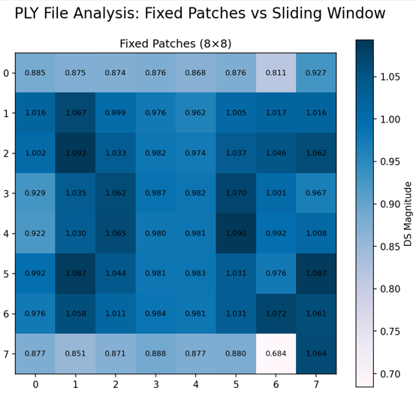
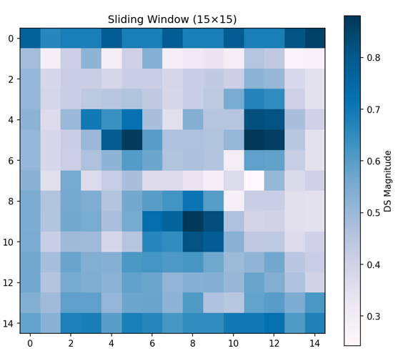
Experimental Validation
Common Configuration Parameters
Subspace Dimension: Set to 3 for all shape subspace computations, balancing dimensionality reduction with geometric representation.
Neighbor Computation: An eight-neighbor approach was consistently applied for Difference Subspace calculation, considering a wider context around each patch/window.
Sliding Window Overlap: Specifically set at 50% for the sliding window method to ensure substantial overlap and increased spatial resolution.
Preprocessing Steps
Centering: All point clouds (both synthetic and real-world) were centered to remove translational variance, ensuring that shape subspace computations focused purely on geometric form.
Optional Downsampling: For very dense point clouds, downsampling could be applied to manage computational load without significant loss of critical detail.
Minimum Point Filtering: A crucial step to ensure that each patch or window contained a sufficient number of points to allow for meaningful and stable shape subspace computation, preventing degenerate cases.

Slide 22
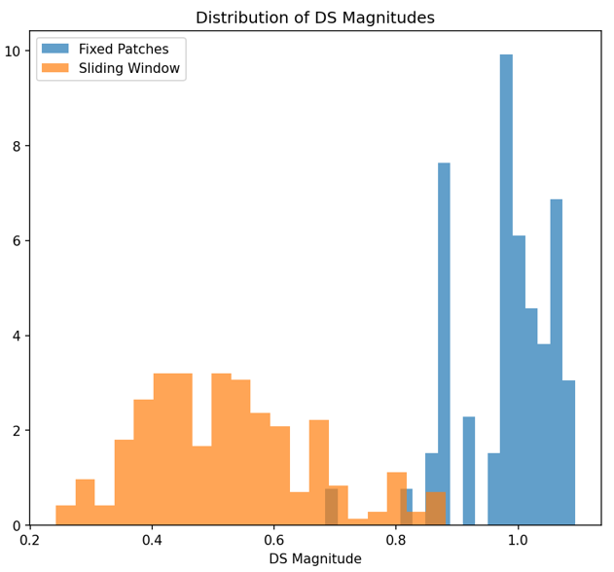
Results: Synthetic Data Performance
Metric | Fixed Patches | Sliding Window
Max DS Magnitude | 0.652 | 0.770
Mean DS Magnitude | 0.494 | 0.445
Resolution Increase | - | 3.6x
Analysis Points | 100 | 361
Improved Peak Detection: The sliding window approach showed an 18% improvement in maximum DS magnitude (0.770 vs. 0.652) for detected anomalies. This indicates a stronger and more distinct signal for anomalies.
Consistent Mean Values: Both methods maintained similar mean DS magnitudes, suggesting that the overall level of "difference" detected across the surface remained comparable, but the peak anomaly signals were enhanced by the sliding window.
Significant Resolution Increase: The sliding window method provided a 3.6x increase in spatial resolution, yielding 361 analysis points compared to 100 for fixed patches. This confirms the theoretical advantage of overlapping analysis in providing a more detailed surface representation.
Visual Confirmation: Heatmaps of DS magnitudes for both methods clearly showed anomaly detection, but the sliding window often produced sharper and more localized anomaly representations.

Slide 23
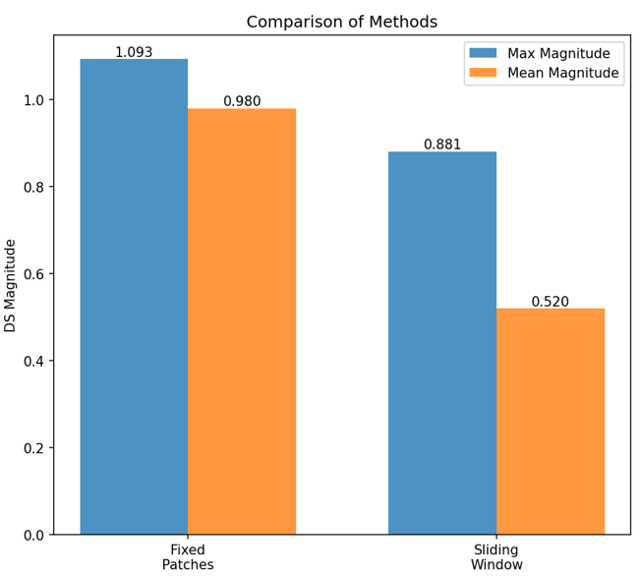
Results: Real-World Data Performance
Metric | Fixed Patches | Sliding Window
Max DS Magnitude | 1.079 | 0.888
Mean DS Magnitude | 0.977 | 0.547
Std Dev DS Magnitude | 0.074 | 0.150
Resolution Increase | - | 3.5x
Analysis Points | 64 | 225
Lower Absolute Peak Magnitudes (Sliding Window): Interestingly, the sliding window showed a lower absolute maximum DS magnitude (0.888 vs. 1.079) on real data. This is a critical observation, as it suggests the sliding window's noise averaging effect might reduce the raw magnitude of all signals, including anomalies.
Significantly Improved Signal-to-Background Ratio: Despite lower absolute peaks, the sliding window achieved a wider dynamic range (0.22-0.89 for sliding window vs. 0.73-1.08 for fixed patches). This indicates that the contrast between anomaly signals and the surrounding noise is much higher, making anomalies stand out more clearly.
Higher Standard Deviation (Sliding Window): The increased standard deviation (0.150 vs. 0.074) for the sliding window suggests better differentiation between anomalous and non-anomalous regions, indicating a more sensitive response to local variations.
Substantial Resolution Increase: Similar to synthetic data, the sliding window provided a 3.5x increase in spatial resolution (225 vs. 64 analysis points), contributing to more precise anomaly localization.
Superior Visual Contrast: As depicted in comparative visualizations (e.g., Figure 2 in the full report), the sliding window approach consistently produced clearer visual contrast for anomaly identification on noisy real data. The overlapping analysis created smoother gradients and more distinct anomaly regions.

Slide 24
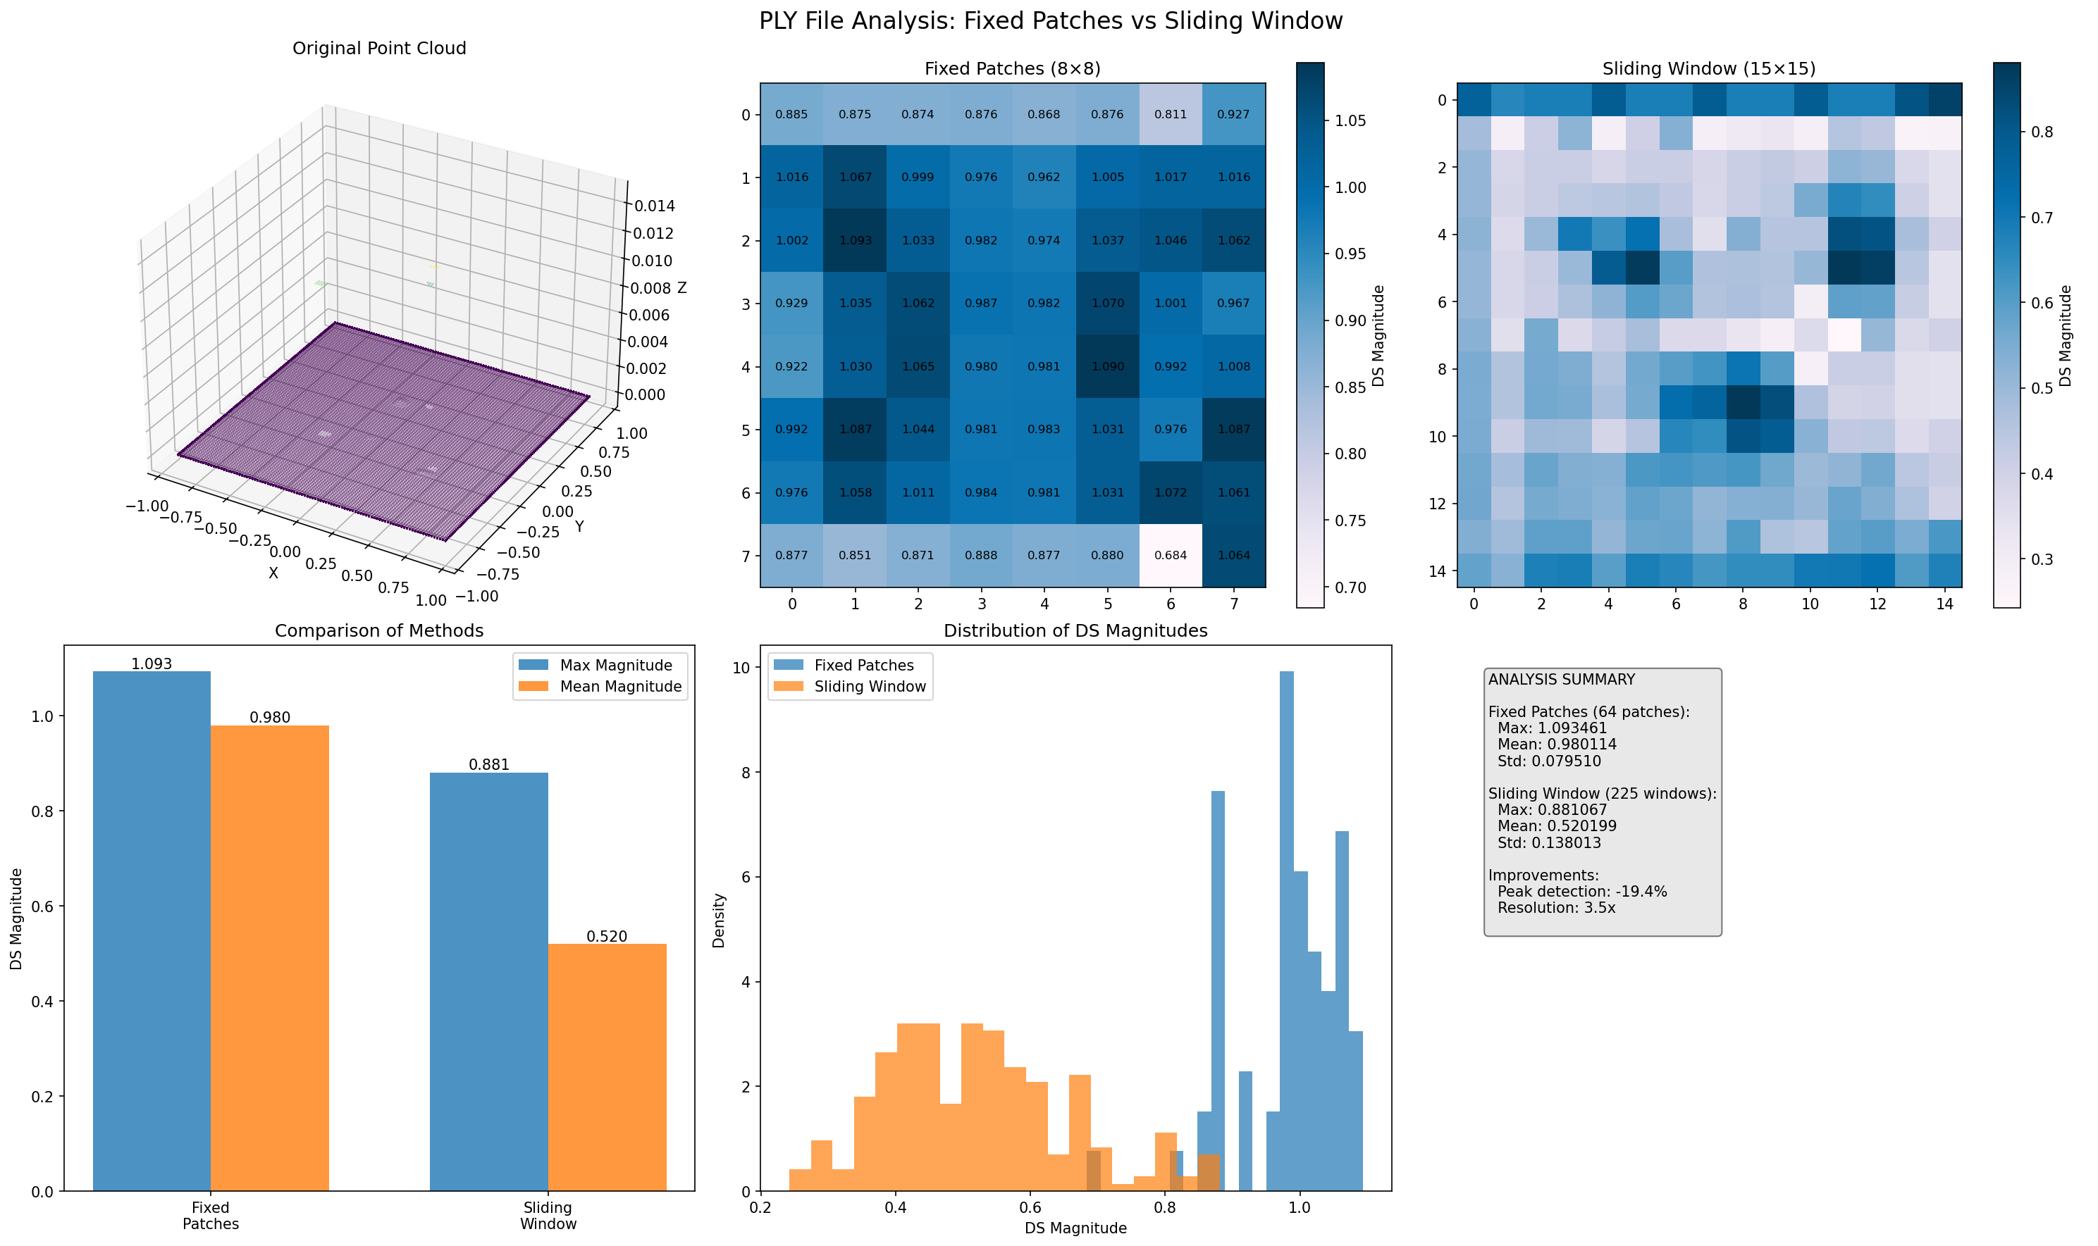
Key Finding: Data-Dependent Performance
Clean Synthetic Data
Performance: Both fixed patch and sliding window methods perform well in detecting anomalies.
Noisy Real-World Data
The sliding window approach outperforms fixed patches in processing noisy real-world point cloud data, offering:
Higher Signal-to-Background Ratio: Sliding window yields a wider dynamic range (0.22–0.89) compared to fixed patches (0.73–1.08), making anomalies more distinguishable from background noise.
Improved Visual Contrast: It suppresses background noise effectively while preserving anomalies, resulting in clearer visualizations with smoother gradients—enhancing both human interpretation and automated detection.

Slide 25
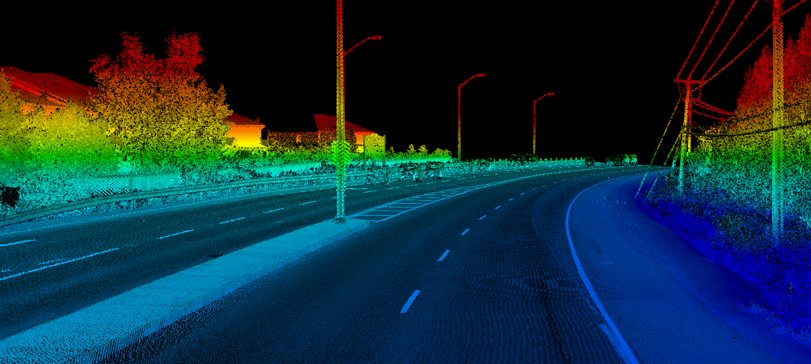
Future Work
Adaptive Parameter Selection
Goal: Eliminate fixed window sizes and overlaps.
Approach: Use algorithms that adaptively choose window size and overlap based on local point density and noise levels, improving robustness across diverse data.
Multi-Scale Analysis
Goal: Capture anomalies of varying sizes.
Approach: Apply a hierarchical sliding window with multiple window sizes to detect both small localized and large diffuse anomalies.
Performance Optimization
Goal: Enable real-time analysis for large datasets.
Approach: Use parallel processing and GPU acceleration to reduce computation time and support high-throughput scenarios.
Notes:
Going forward, our research will focus on introducing noise into the synthetic floor dataset to evaluate the robustness of our method under realistic conditions.
We also plan to apply the method to real-world datasets, such as industrial surfaces and natural terrains, to further validate its applicability.
Additionally, optimizing computational efficiency will be crucial to handle larger datasets and enable real-time processing, which is essential for applications in manufacturing and autonomous robotics.

Slide 26
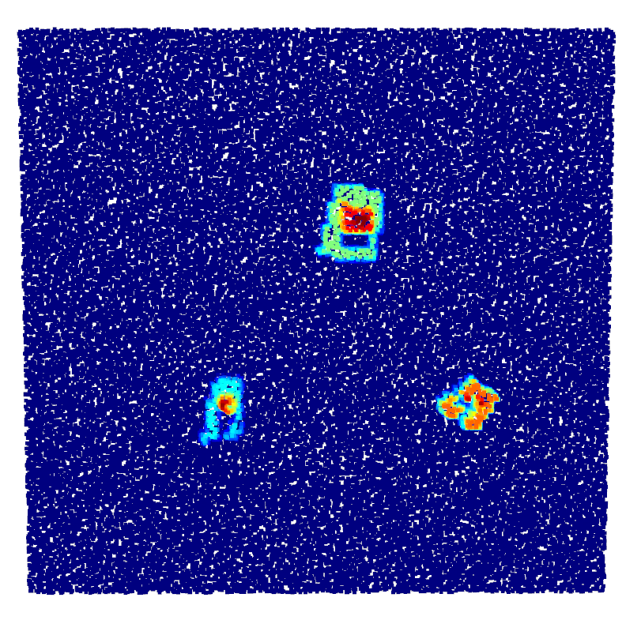
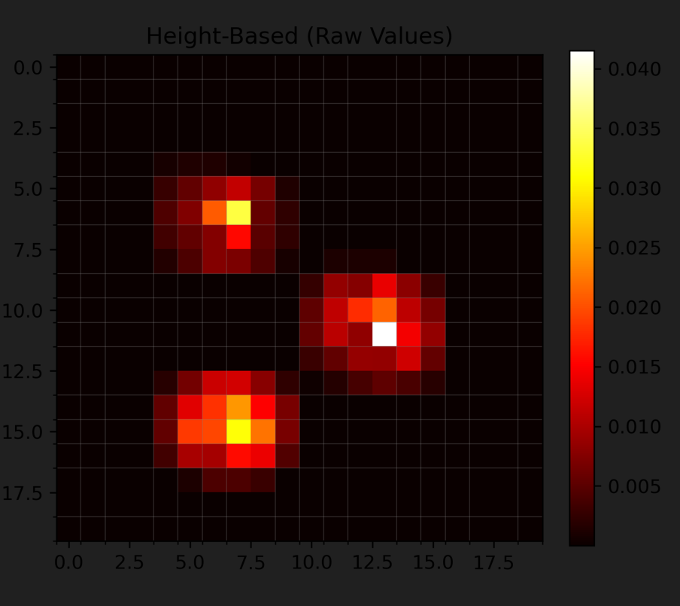
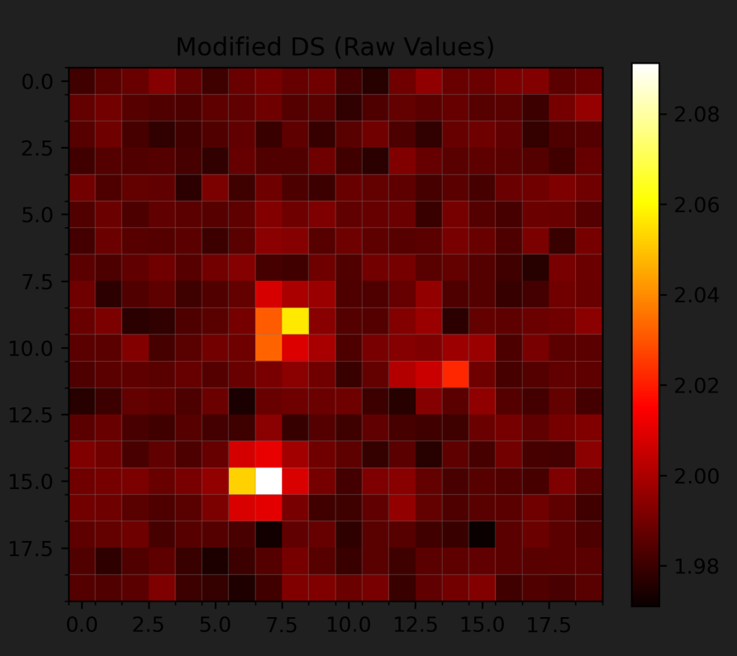
3D mesh

Slide 27
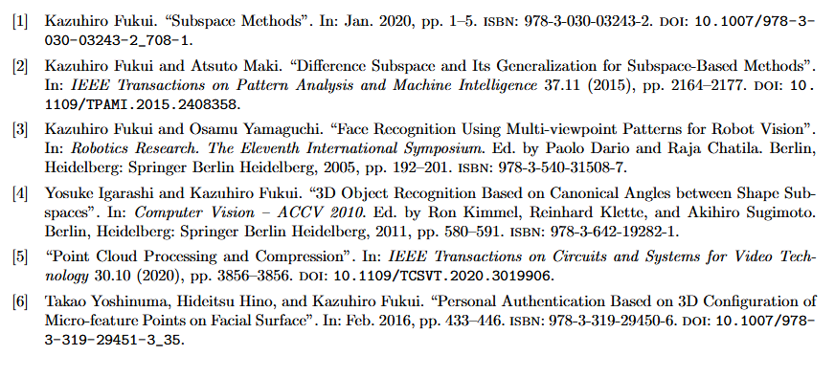
References

